Slide 1
OPER 623 – Heuristic Search Methods
Lesson 12
Tabu Search

Slide 2
Outline
Tabu Search (TS)
Background and Overview
Memory
Aspiration
Neighborhoods
Stop Criteria
Example
Other enhancements

Slide 3
Outline
Tabu Search (TS)
Background and Overview
Memory
Aspiration
Neighborhoods
Example
Stop Criteria
Other enhancements

Slide 4
Motivation
You’ve lost your car keys, how do you find them?

Slide 5
TS Background
What do we do when searching?
Avoid self-defeating actions
Keep a memory of search experience
Thoroughly search promising areas
Examine new search areas only if necessary
Learn from the search

Slide 6


Tabu Search (TS) Background
Developed by Fred Glover in mid 80s
Arose from an AI project course as a student
Trying to get the computer to emulate (human) problem solving
His scenario involved fellow students solving an optimization problem
Found they followed a fairly systematic (deterministic) approach
Further refined at UT with Laguna and Barnes
Tabu Search by Glover and Laguna (1997)
One of the most used, and most successful, metaheuristics
Basic idea: Use memory to learn from the search & adapt to guide the search

Slide 7
Tabu = Taboo
ta·boo [təˈbo͞o, taˈbo͞o]
NOUN
taboos (plural noun) · tabu (noun) · tabus (plural noun)
a social or religious custom prohibiting or forbidding discussion of a particular practice or forbidding association with a particular person, place, or thing.
synonyms: prohibition · proscription · veto · interdiction · interdict · ban · restriction · [more]
ADJECTIVE
tabu (adjective)
prohibited or restricted by social custom.
synonyms: forbidden · prohibited · banned · proscribed · vetoed · ruled out · [more]
VERB
tabu (verb)
place under prohibition.
"traditional societies taboo female handling of food during this period"

Slide 8

Tabu Search
How does a search heuristic avoid getting trapped by a local minima?

Slide 9
Tabu Search
If you allow ‘bad’ moves (like SA) but don’t escape the ‘gravity’ of the local minima…

Slide 10
Tabu Search
You fall right back into the same local minima you just moved out of!

Slide 11
Tabu Search
Tabu search creates a list of Tabu moves preventing this

Slide 12
Tabu Search 10,000 foot view
Start at a complete solution
Use ‘some’ local search method
Keep a memory of best solution to date
Maybe a memory of multiple really good solutions…
Create a list of Tabu moves (disallowed moves)
User defined criteria for what goes into this list…
Maybe multiple lists, or maybe Tabu attributes instead of moves…
If a move exists that is better then best known solution… Make that move – Even if it is a Tabu Move
May be other criteria that allow you to break Tabu’s …
Tabu Search is tunable… very very tunable

Slide 13
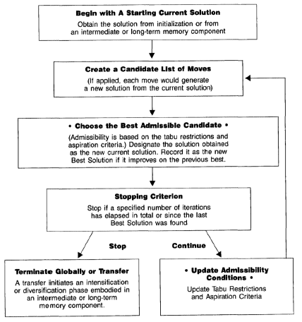
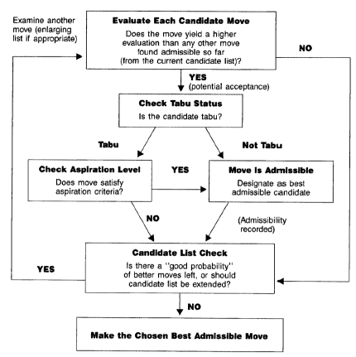
Tabu Search Framework
Next slide

Slide 14
“Choose the Best Admissible Candidate”

Slide 15
“Choose the Best Dessert”
Triple Fudge Ripple Pie
Crème Brule
Vanilla Ice Cream
Baked Alaska
Vanilla Ice Cream
Ice Cream?
Triple Fudge Ripple?

Slide 16
Outline
Tabu Search (TS)
Background and Overview
Memory
Aspiration
Neighborhoods
Example
Stop Criteria
Other enhancements

Slide 17
TS Memory
What gets you on the naughty list?
Tabu Criteria
Attributes of a move or solution making that move or solution “off limits”
Tabu List
Memory structure of attributes that are currently tabu
Tenure
Number of iterations for which an attribute remains tabu
What attributes do you store on list?
How long do you stay on list?

Slide 18
What gets you on the Tabu list
Recent Moves
Prevent Cycling - Keep recent variables from toggling back and forth
Don’t search under the cushions twice!
Frequent Moves
Freeze frequently changed nodes or edges
Combinations
Freeze combinations of recently moved nodes/edges
Keep variables in (or out) of the basis

Slide 19

What do you store in Memory?
Types of Memory
Recency-based
When did I last see this solution?
When did I last make this move?
Frequency-based
How often have I seen this solution?
How often have I made this move?
Quality-based
What attributes are common in good solutions?
Influence-based
Resulting change in objective function

Slide 20
How long do you stay on list? Tabu Tenure
Short term
“Forgets” after specified number of iterations
Used for recency-based memory
Long term
Builds as the search progresses
“Remembers” for duration of search
Frequency based memory
Best solution memory

Slide 21
Tabu Tenure
Static tabu tenure – remains constant
No agreement on a “best” tenure
Multiple tabu lists may each have different tenures
The more restrictive the attribute the shorter the tenure
Usually determined through empirical testing
Dynamic tabu tenure
Typically provide better results vs static
Allocate longer tenures to moves that reverse high quality solutions
Active research area

Slide 22
Outline
Tabu Search (TS)
Background and Overview
Memory
Aspiration
Neighborhoods
Example
Stop Criteria
Other enhancements

Slide 23
Aspiration criteria
Aspiration criteria allow you to override tabu status
TS mechanism to escape local minima
Do not want to miss good solutions
There can be multiple aspiration criteria involved
Aspiration criteria can have a tenure
Early on many (or ‘easy’) criteria (diversification)
Can be based on constraint violation as well as objective function evaluation
Typical criteria:
Best-so-far – Default for TS
Best found in some set of solutions
Best according to some other criteria (example: most feasible)

Slide 24
Diversification vs Intensification
Diversification strategies modify choice rules to encourage exploration of previously unexplored areas of the solution space.
Aspiration criteria (and tabu criteria) may encourage diversification early on (High temperature in SA)
Intensification strategies modify choice rules to encourage combinations and solution features historically found good.
Aspiration criteria (and tabu criteria) may encourage intensification later on (low temperature in SA)

Slide 25
Diversification vs Randomness
Simulated Annealing encourages randomness
Memoryless
Tabu search encourages diversification
Adaptive Memory
What’s difference?
Diversification is based on setting tabus, tenure, and aspiration such that you intelligently explore new sequences and regions.
“The hypothesis of tabu search…is that recourse to diversification is more appropriate (and more powerful)… then recourse to randomization” Reeves

Slide 26
Outline
Tabu Search (TS)
Background and Overview
Memory
Aspiration
Neighborhoods
Example
Stop Criteria
Other enhancements

Slide 27
TS Search Neighborhood
Solution-based or move-based?
Typically easier to ensure we don’t revisit solutions with solution-based attributes
How many attributes do we use?
We could have multiple tabu lists
Ex. Added edge list and deleted edge list
How specific?
Does the attribute explicitly define the move/solution?
More specific – slower movement through the search space
More general – faster movement
How large?
Tradeoff between diversification and speed

Slide 28
Outline
Tabu Search (TS)
Background and Overview
Memory
Aspiration
Neighborhoods
Example
Stop Criteria
Other enhancements

Slide 29
TS Example (Glover, Interfaces 1990)
Consider a minimum cost spanning tree problem which includes constraints
Constraints prevent certain edge pairings.
So neither Prim’s nor Kruskal’s algorithm are guaranteed to find the optimal or even feasible!
Consider the following tree with the additional side constraints
x₁ + x₂ + x₆ < 1
x₁ < x₃

Slide 30
TS Example
Establish a penalty of 50 per unit of violation
Define neighborhood
A move will be an edge swap
Add one edge, drop one edge
Must not form a cycle
Select best admissible move (lowest cost tree with penalties)
Tabu restriction
Can’t drop last two added edges
Aspiration criteria
Allow move if it provides best tree found so far
x₁ + x₂ + x₆ < 1
x₁ < x₃

Slide 31
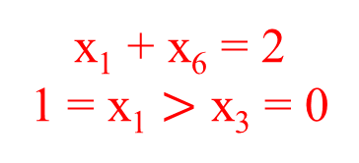
TS Example
First: Use Prims to obtain a solution independent of the side constraints
Current Cost: 16 +100
x₁ + x₂ + x₆ < 1
x₁ < x₃
x₁ + x₆ = 2
1 = x₁ $>$ x₃ = 0

Slide 32
TS Example
Edge Leaving Edge Entering
Edge in Tree Tabu Edge
Iteration One:
Candidate list – edges x₃, x₂, x₇
Evaluate all neighbors
Add x₃, drop x₁, value 28
Add x₃, drop x₄, value 32+50
Add x₃, drop x₅, value 34+50
Add x₂, drop x₁, value 19+50
Add x₂, drop x₄, value 23+150
Add x₇, drop x₆, value 20+50
Add x₇, drop x₄, value 26+100
Add x₇, drop x₅, value 28+100
Tabu List: empty
Selected move – Add x₃, drop x₁
Current cost – 28 (new best, local optimum)
Best cost - 28
Add x₃ to the tabu list
x₁ + x₂ + x₆ < 1
x₁ < x₃

Slide 33
TS Example
Edge Leaving Edge Entering
Edge in Tree Tabu Edge
Iteration Two:
Candidate list – edges x₁, x₂, x₇
Moves
Add x₁, drop x₃, value 16+100 - tabu
Add x₁, drop x₄, value 32+50
Add x₁, drop x₅, value 34+50
Add x₂, drop x₃, value 19+150 - tabu
Add x₂, drop x₅, value 37+100
Add x₇, drop x₆, value 32
Add x₇, drop x₄, value 38
Add x₇, drop x₅, value 40
Tabu List: x₃ - 1 more turn
Selected move – Add x₇, drop x₆
Current cost – 32 (feasible)
Best cost - 28
Add x₇ to the tabu list
x₁ + x₂ + x₆ < 1
x₁ < x₃

Slide 34
TS Example
Edge Leaving Edge Entering
Edge in Tree Tabu Edge
Iteration Three:
Candidate list – edges x₁, x₂, x₆
Moves
Add x₁, drop x₃, value 44+50 – tabu
Add x₁, drop x₄, value 36
Add x₁, drop x₅, value 38
Add x₂, drop x₃, value 23 – tabu*
Add x₂, drop x₅, value 41
Add x₆, drop x₄, value 38
Add x₆, drop x₅, value 40
Add x₆, drop x₇, value 28 – tabu
Tabu List – x₃ - 0 more turns
x₇ – 1 more turn
Selected move – Add x₂, drop x₃ by aspiration criteria
Current cost – 23 (new best, local optimum)
Best cost - 23
Add x₂ to the tabu list
x₁ + x₂ + x₆ < 1
x₁ < x₃

Slide 35
TS Example
Edge Leaving Edge Entering
Edge in Tree Tabu Edge
Iteration Four:
Candidate list – edges x₁, x₃, x₆
Moves
Add x₁, drop x₂, value 20+50 – tabu
Add x₁, drop x₄, value 27+100
Add x₃, drop x₂, value 32 – tabu
Add x₃, drop x₅, value 41
Add x₆, drop x₄, value 29+50
Add x₆, drop x₅, value 31+50
Add x₆, drop x₇, value 27+50 – tabu
Tabu List: x₂ – 1 more turn x₇ – 0 more turns
Selected move – Add x₃, drop x₅
Current cost – 41 (feasible)
Best cost - 23
Add x₃ to the tabu list
x₁ + x₂ + x₆ < 1
x₁ < x₃

Slide 36
Outline
Tabu Search (TS)
Background and Overview
Memory
Aspiration
Neighborhoods
Example
Stop Criteria
Other enhancements

Slide 37
TS Stop Criteria
“This is the heuristic that never ends, it just goes on, and on…
We achieved global optimal solution iteration 3…. But we didn’t know it… so we kept going
How do you know when to stop?
Stop after a fixed a-priori set number of iterations
Stop after no improvement for a fixed consecutive number of iterations
Dynamic?

Slide 38
Outline
Tabu Search (TS)
Background and Overview
Memory
Aspiration
Neighborhoods
Example
Stop Criteria
Other enhancements

Slide 39
TS Other Enhancements
TS is one of the most user tune-able meta-heuristics
Following are small subset of possible enhancements
Stochastic versus deterministic move choices
Probabilistic mechanisms in Tabu list tenure
Aspiration criteria
Path-relinking
Force explorations between “elite” solutions
Feasibility tunneling
Force solutions to cross thru constraints to infeasibility, then slowly come back to feasibility
Dynamic Neighborhoods
Early on large neighborhoods to favor diversification
Later on small neighborhoods to favor intensification

Slide 40

Break

Slide 41
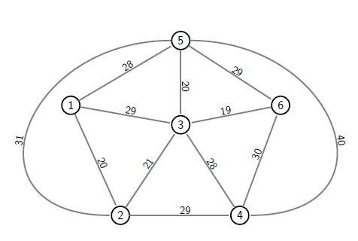
TS Example
Consider a minimum cost spanning tree problem which includes constraints
Consider the following tree with the additional side constraints
What decisions do you need to make regarding TS parameters?
Implement a TS in your groups.
x₃₅ + x₃₆ < 2 x₄₅
x₂₃ < x₃₆

